Slide 1
INTERNSHIP TASK -4
SPEECH
RECOGNITION
SYSTEM
KEVIN VICTOR
Intern ID : CTIS8913

Slide 2
TASK 4
BUILD A BASIC SPEECH RECOGNITION
SYSTEM FOR COMMAND-BASED CONTROL OF
DEVICES USING AN EMBEDDED BOARD

Slide 3
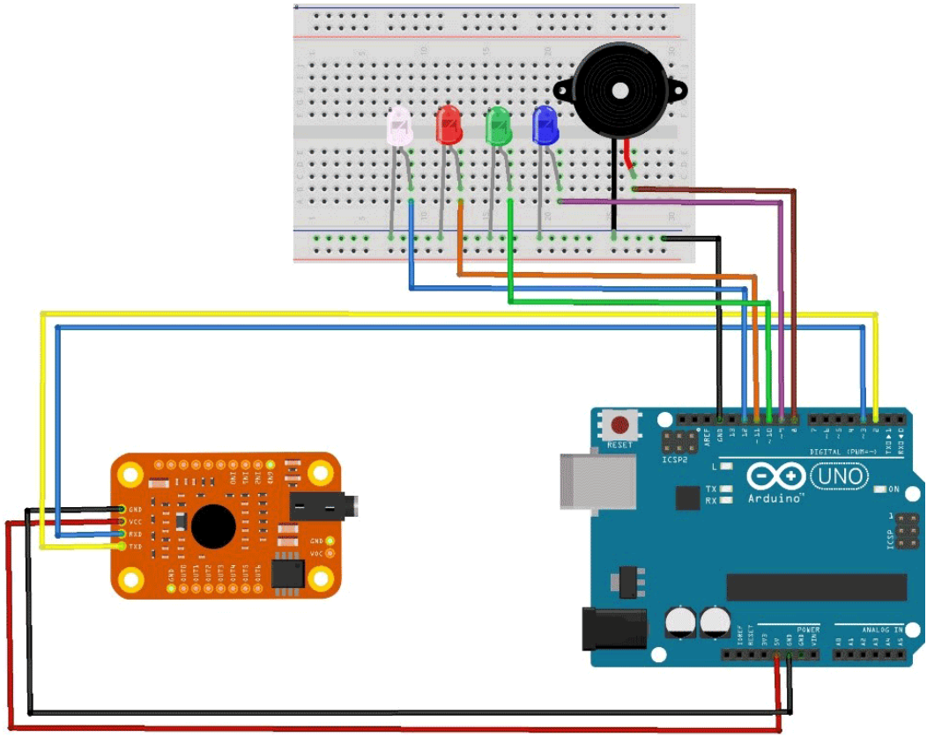
CIRCUIT DESIGN
Components
Buzzer
Arduino Uno R3
LED Bulb ( 4 nos )
1. Voice Recognition Module

Slide 4
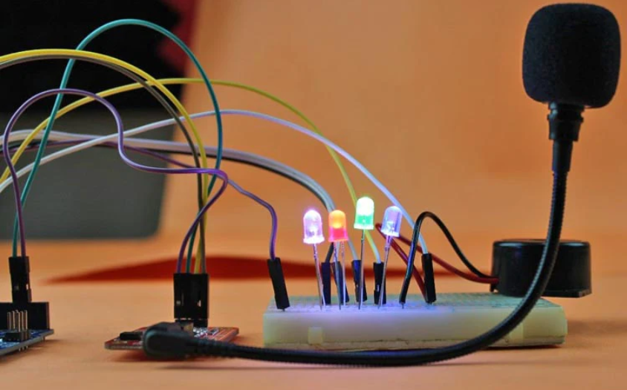
OUTPUT DEMONSTRATION

